Slide 1
SUMOBOT prototype

Slide 2
SUBTITELS
Literature review
Electrical design
Mechanical design
Flowchart

Slide 3
introduction
The purpose of this project is to make the participants able to participate in RoboGames by use of SumoBots that are highly effective and operational such that in the end they emerge to be winners.

Slide 4
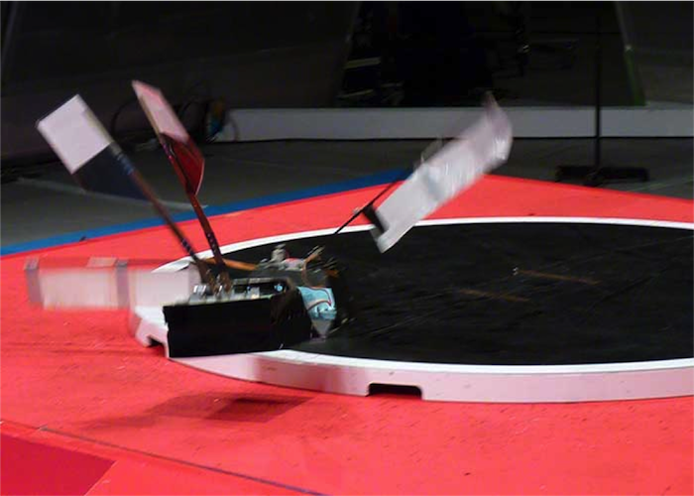
In this project, the team is required to participate and compete in a SumoBot competition held by RoboGames.
This competition has similar rules to the traditional Japanese sumo sport which mainly aims to push the opponent outside the ring.
Two robots are competing. The ring is circular and has varying dimensions depending on the class, and each robot starts in a set line called shikari lines inside the ring.
Each match has three rounds, and the team wins a round when the opponent’s SumoBot touches the outside ring of the arena.
The teams follow the rules and regulation set by RoboGames which states that it is not allowed to damage or flip the opponent Bot.

Slide 5
Requirements | Target
Maintenance | Once per competition
Effective from all sides | All sides are equally powerful
Size | 20x20cm
Competitive | Fast enough to maneuver in attack and defense.
Remote Controlled | Fully controlled and easy to operate.
No Autonomous Features | Does not have any sensors or autonomous codes.
Safety | Does not damage other SumoBots.
Weight | <3kg

Slide 6
.
Existing Design #1: Sand Flea
The Newest Generation SumoBot “Sand Flea” was created by Boston dynamics and is appropriate benchmarking design in relation to the project.
This is because it has some specifications that can be applied in the current device that is being designed.
Its specifications include:
Battery and propane powered;
has a weight of 5Kg,
a height of 15cm,
and 5 joints.
It is able to make jumps of up to 10m and 25 bounces per charge.
These specifications are appropriate for the device in our project.
For instance, the battery used in the SumoBot Sand Flea can be incorporated into our design.
The device does not have protruding edges and hence it is safe to the opponent SumoBots.
It also has an appropriate size which is within the range of 20x20cm hence making it easy to store and transport from one point to another.
In addition is made up of high-quality materials which are strong hence making it to be highly durable.
The only problem of this device which is to be made in our project is that it exceeds the weight of 3kgs since it weighs 5Kgs.
As shown in the following figure

Slide 7
Existing Design #2: Bluetooth Powered SumoBot
The Bluetooth Powered SumoBot is a recent technology which enables the users to operate it using Bluetooth. The design has some specifications which are beneficial to our design such as a low cost of 90$. This is because it is made up of a few components which are cheap. Also, the device has a few linkages and hence this specification can be incorporated in our device so as to reduce the time taken for assembly. The few linkages translate into a few components which makes the device to be light in weight hence can be carried from one point to another with ease .The fact that it is Bluetooth controlled makes it to qualify as a device which is RC controlled. That is why it has been given the name Bluetooth Powered SumoBot. The microprocessor which have been applied to facilitate its effectiveness in use of Bluetooth can be incorporated in our SumoBot device. However, its cons are that it is not hardy enough since it is made up of materials which are light in weight and not of low quality. In this manner the device is not able to last for a long period of time. In addition, the sharp edges which are on its sides make the device to be highly hazardous.

Slide 8
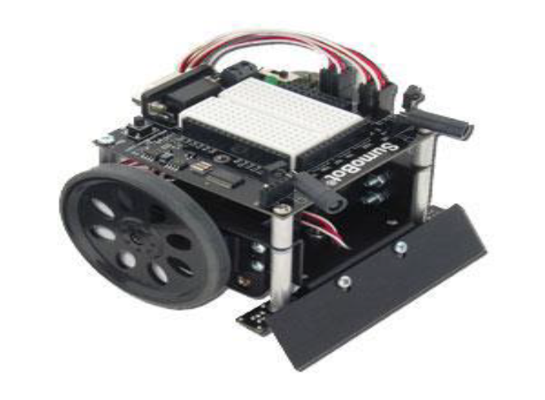
Existing Design #3: Parallax SumoBot
Parallax SumoBot is manufactured by Trossen Robotics and has specifications which are useful to our design. The SumoBot is controlled by use of a remote control, a 4AA power pack and servo motors. The 4AA power pack ensures that the device is supplied with the right amount of power to facilitate effective operation. In addition, it has 2 module and infrared sensors to detect your opponent and the edge of the Sumo Ring. As a result, it enables the player to detect when opponent is ready to strike and hence prepare in advance how to make an appropriate move or counter attack. The device has high levels of safety since it has sensor inputs .The major cons are that the device is made up of numerous components hence making its assembly to be too complicated. This also makes the device to have a lot of linkages hence making its assembly to be difficult. The device is not hardy and hence it cannot last for a long period of time.

Slide 9
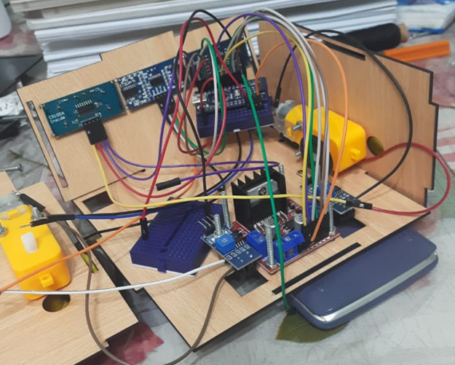
At first, it was planned that a breadboard and wire jumpers will be used for the sumo-bot,
however we found that it is :
an inefficient and unreliable method
as the robot is vulnerable to mechanical vibrations
when it is in motion, which can cause some of the
electronic components to be disconnected, so errors
might be experienced.
there are multiple connections used in a very small
area, which makes it more difficult for us to trace
the electrical connections are made correctly or not
while testing the prototype.
As shown in the following picture:
Electrical design

Slide 10
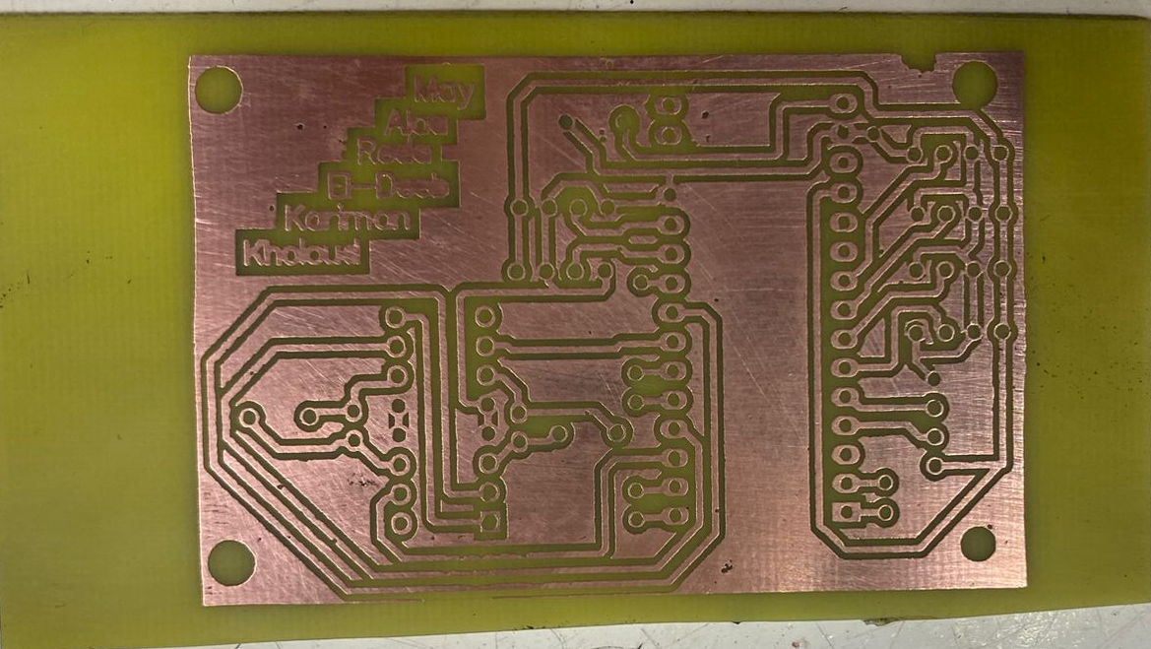
That is why a PCB is designed consisting of all of the inputs (sensors) and outputs (motors) in a compact size, in order to ensure that the circuit is stable so the robot can continuously operate without experiencing any loose connections or electronic noise.
As shown in the next picture:

Slide 11
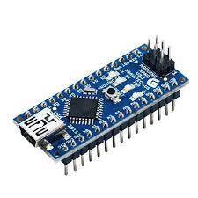
Besides, we used Arduino nano instead of Arduino uno,
Because it is smaller in size which easily fits inside the robot model
Has greater number of ports which we found more suitable for our robot, because of having many electrical connections.

Slide 12
We were in a debate of whether it is better to use three ultrasonic sensors or two IR sensors with a single ultrasonic sensor on the front top part of the robot, in order to increase the robot’s accuracy in detecting the opponent robot.
Then after doing our research, we discovered that using more than one ultrasonic sensor can cause inaccurate results,
Because they are very susceptible to noise due to many sound waves being transferred and received in the same range where this interference makes it difficult or impossible to measure the distance.
Also, the opponents’ robots might be smaller than ours and may have odd shapes that would not reflect the ultrasonic waves, which is another difficulty encountered.

Slide 13
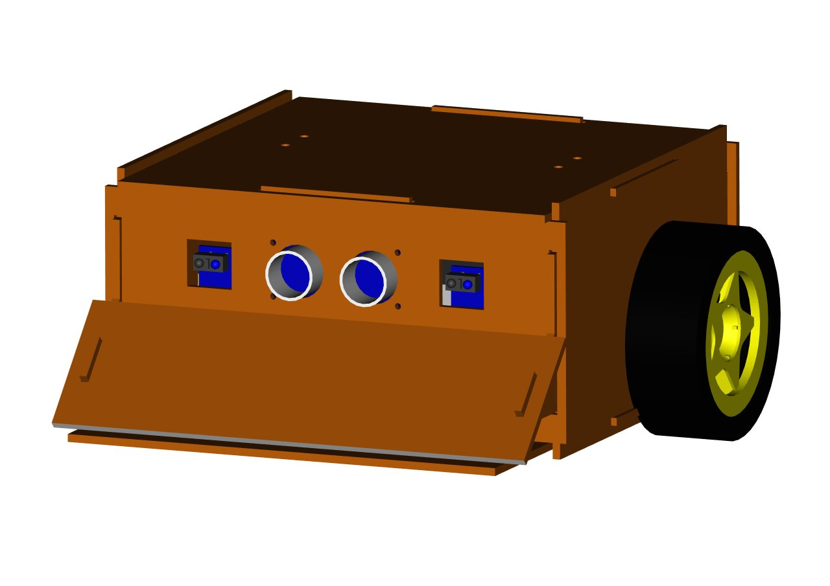
That is why we used :
A single ultrasonic sensor to have reliable results by measuring the distance accurately
Two IR sensors to easily detect any smaller robots accurately since it is faster in response and has much more focused beams that is not easily interfered with.
As shown in the following figure:

Slide 14
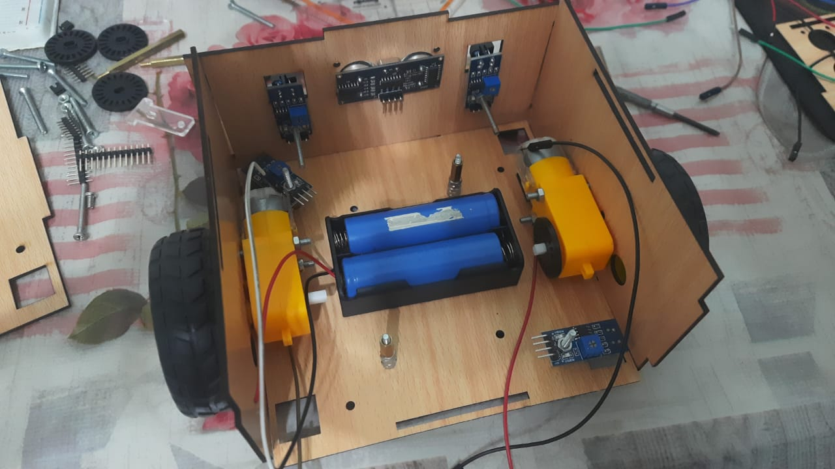
We used 4 IR sensors (TCRT5000) at the bottom of the robot to ensure that the robot won’t get out of the black field.
There are two IR sensors located on the front bottom to check if the white ring is in front of it, so it can avoid it by turning to the right or to the left
also the two IR sensors on the back bottom have the same rule for detecting the white ring but if it is behind the robot.
As shown in the figure:

Slide 15
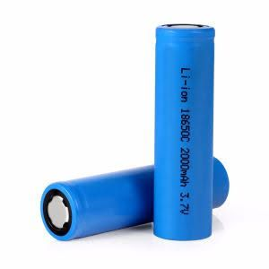
Lithium batteries are used because it is cheap and gives out high current .

Slide 16
Mechanical design
The mechanical design of the prototype is made in small dimensions which meets the rules of the competition.
It contains holes at the bottom for the ir sensors which are used to detect the circle and holes in the front for the ultrasonic sensor and the ir sensor which are used to detect the opposite robot.
At the front of the design there is a slider which can lift the opposite robot at the moment of collision which will make it easier for the robot to carry it out of the circle.
We are using two high torque geared dc motors which we be easier in control than using four motors in the back of the robot letting the front of the robot in friction with the ground to make the robot harder to be pushed and keep the front of the robot at lower level than its opponent and this will make the lifting of the opposite robot easier.

Slide 17
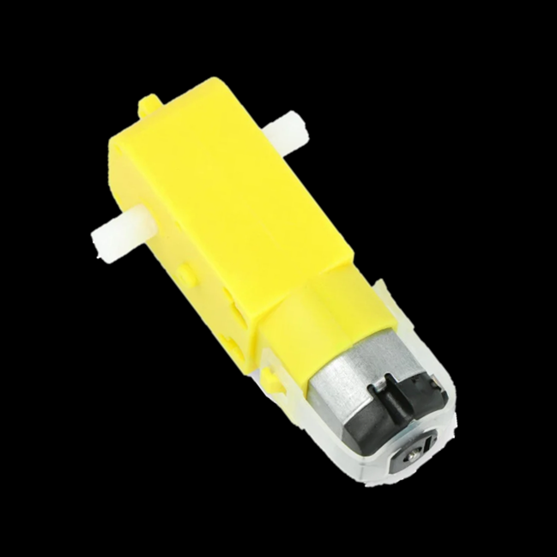
THE MOTORS
In the prototype a yellow dc geared motor is used.
The motor has a gear box with ratio 48:1 which is increase the torque of the motor to 0.8 kg*cm (0.078 Nm) and the motor can rotate at 90 ± 10 rpm.
The motor is operated at 5 volts and draws an average current of 250mA maximum.

Slide 18
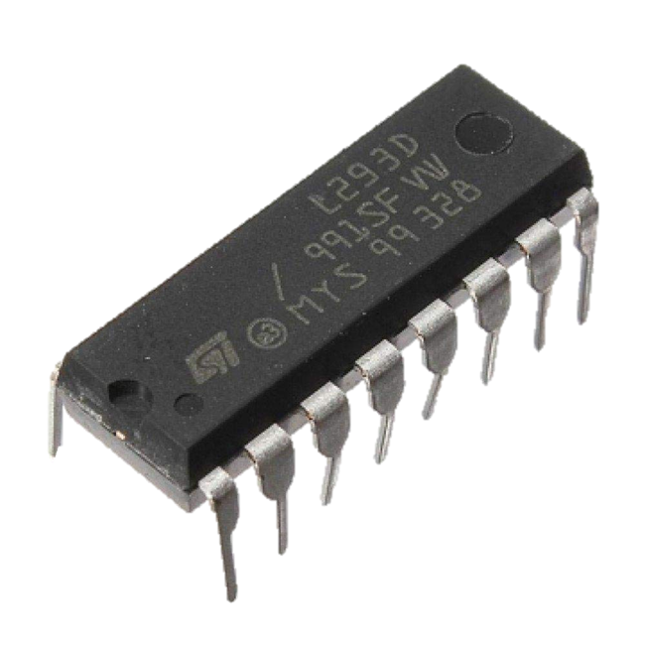
THE MOTOR DRIVER
In the prototype l293D motor driver IC is used which is capable of controlling motors with operating voltages up to 36 volts and maximum output current up to 1.2 ampere.
This motor driver will be very good in our application because it can control the used geared dc motor and its size is small.

Slide 19
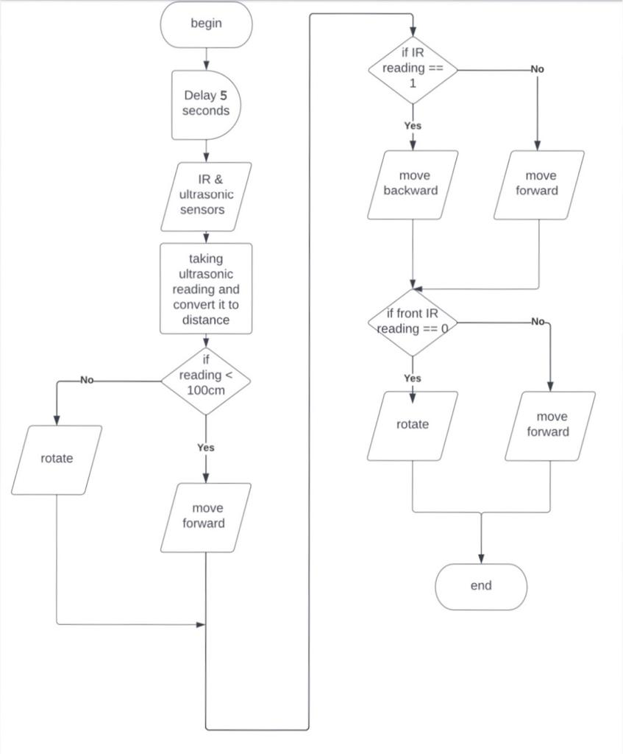
Flowchart

